Slide 1
CS 331
Topic: The Standard Template Library Part 2
MD Romael Haque

Slide 2
The map, multimap, and unordered_map Classes
A map is an associative container.
Each element that is stored in a map has two parts: a key and a value.
In fact, map elements are commonly referred to as key-value pairs.
When you want to retrieve a specific value from a map, you use the key that is associated with that value.
This is similar to the process of looking up a word in the dictionary, where the words are keys and the definitions are values.

Slide 3
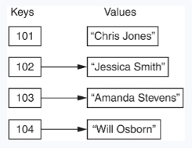
The map, multimap, and unordered_map Classes
For example, suppose each employee in a company has an ID number, and we want to write a program that lets us look up an employee’s name by entering that employee’s ID number.
We could create a map in which each element contains an employee ID number as the key and that employee’s name as the value.
If we know an employee’s ID number, then we can retrieve that employee’s name.

Slide 4
The map, multimap, and unordered_map Classes
Another example would be a program that lets us enter a person’s name and gives us that person’s phone number.
The program could use a map in which each element contains a person’s name as the key and that person’s phone number as the value.
If we know a person’s name, then we can retrieve that person’s phone number.
Key-value pairs are often referred to as mappings because each key is mapped to a value.

Slide 5
The map Class
The STL provides a map class template that you can use to define a map container in your programs.
The map class provides many member functions for storing elements, retrieving elements, deleting elements, iterating over the map, and much more.
To use the map class, you need to #include the <map> header file in your program.
Then, you can define a map object using one of the map class constructors

Slide 6
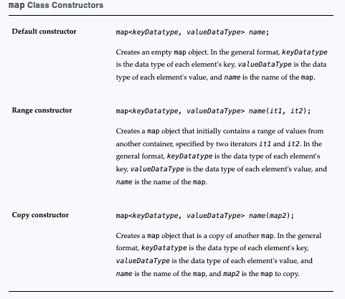
map Class Constructors

Slide 7
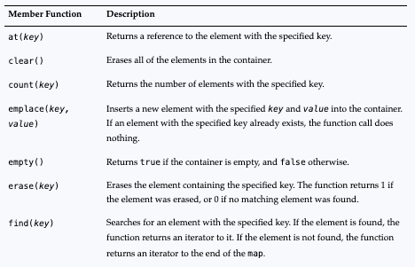
Map member functions

Slide 8
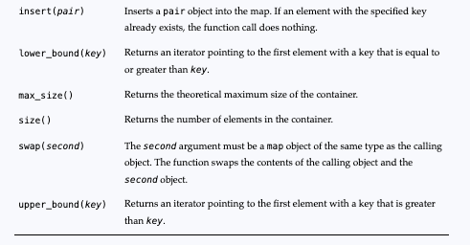
Map member functions

Slide 9
Map member functions
In common with most STL containers, the map class has member functions that return iterators to the beginning and end of the container.
Specifically, the class has begin(), cbegin(), cend(), crbegin(), crend(), rbegin(), and rend() member functions that return various combinations of regular, reverse, and constant iterators.
Unlike the sequence containers array and vector, associative containers like map do not have front() and back() iterator functions.

Slide 10
The map Class
Here is an example of how you might define a map container to hold employee ID numbers (as ints) and their corresponding employee names (as strings):
map<int, string> employees;
This statement defines a map container named employees.
Inside the angled brackets <>, the first data type (int) is the type of the map’s keys, which in this case are the employee ID numbers. The second data type (string) is the type of the associated values, which in this case are the employee names.

Slide 11

Initializing a Map
You can initialize a map with an initialization list.
The following code shows an example:
Notice that inside the initialization list:
The initialization list is enclosed in a set of curly braces {}
Each element is enclosed in its own set of curly braces, with the key and the value separated by a comma
The elements are separated by commas

Slide 12
Initializing a Map
The keys in a map container must be unique. No two elements in a map container can have the same key value.
If two or more elements in an initialization list have the same key, only the first will be added to the map.
The others will be ignored.

Slide 13
Adding Elements to a Map
The map class overloads the [] operator, giving you the ability to add new elements to a map with an assignment statement in the following general format:
mapName[key] = value;
In the general format, mapName is the name of the map, and key is a key.
If key already exists in the map, its associated value will be changed to value.
If the key does not exist, it will be added to the map, along with value as its associated value.

Slide 14
Adding Elements to a Map
The following code shows an example:
map<int, string> employees;
employees[110] = "Beth Young";
employees[111] = "Jake Brown";
employees[112] = "Emily Davis";
The first statement creates an empty map container named employees.
The statements that follow then add the elements to the map

Slide 15
Adding Elements to a Map
Remember, the keys in a map must be unique.
If you assign a new value to an existing key, the new value will replace the previously stored value.
For example, look at the following code:
map<int, string> employees;
employees[110] = "Beth Young";
employees[110] = "Jake Brown”;

Slide 16
Adding Elements with the insert() Member Function
When an element is stored in a map, it is stored as object of the pair type.
The pair type is a struct that has two member variables: first and second.
The element's key is stored in the first member variable, and the element's value is stored in the second member variable.

Slide 17
Adding Elements with the insert() Member Function
The map class provides an insert() member function that adds a pair object as an element to the map.
You can use the STL function make_pair to construct a pair object, as shown in the following code:
map<int, string> employees;
employees.insert(make_pair(110, "Beth Young"));
employees.insert(make_pair(111, "Jake Brown"));
employees.insert(make_pair(112, "Emily Davis"));

Slide 18
Adding Elements with the emplace() Member Function
The map class provides an emplace() member function that constructs a new element in the container.
You simply call the member function, passing the new element's key and value as arguments.
The following code shows an example:
map<int, string> employees;
employees.emplace(110, "Beth Young");
employees.emplace(111, "Jake Brown");
employees.emplace(112, "Emily Davis");
If the element that you are inserting with the insert() or emplace() member function has the same key as an existing element, the function will not insert the new element.

Slide 19
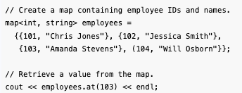
Retrieving Values from a Map
To retrieve a value from a map, you call the at() member function, passing the key that is associated with the desired value.
If the specified key exists in the container, the function returns its associated value.
If the key does not exist, the function throws an exception.

Slide 20
Retrieving Values from a Map
If the key that you pass to the at() member function does not exist in the map, the at() member function will throw an exception.
To prevent this, you should first call the count() member function to determine whether the key exists in the map.
You call the count() member function, passing a key as the argument.
If the specified key exists in the container, the function returns 1. If the key does not exist, the function returns 0.

Slide 21
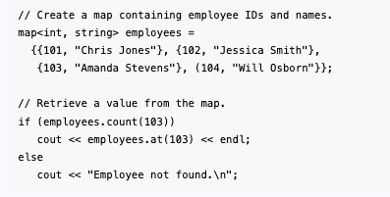
Retrieving Values from a Map

Slide 22
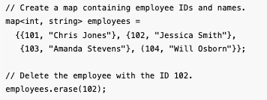
Deleting Elements
You can delete, or erase, an element from a map using the erase() member function.
You call the erase() member function, passing the key that is associated with the element you want to erase.
The erase() member function returns 1 if the specified element was successfully erased, or 0 if it was not found.

Slide 23
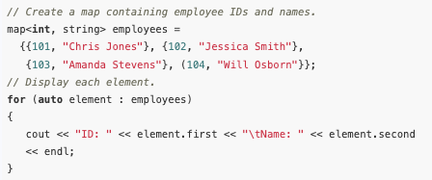
Iterating Over a Map with the Range-Based for Loop
The range-based for loop is a convenient way to iterate over all of the elements in a map.
The following code shows an example of how to display all of the elements in a map:

Slide 24
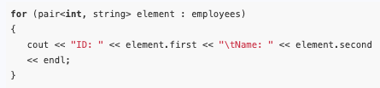
Iterating Over a Map with the Range-Based for Loop
Notice that we used the auto key word in the declaration of the range variable, element.
The auto key word tells the compiler to determine the variable's data type from the context in which it is being used.
If we had written the actual data type of the element variable, the loop would have looked like this:

Slide 25
Using an Iterator with a Map
You can use a bidirectional iterator to access the elements of a map.
The map class has a begin() member function that returns an iterator pointing to the first element in the map.
Also, an end() member function that returns an iterator pointing to the end of the map (the position after the last element).

Slide 26
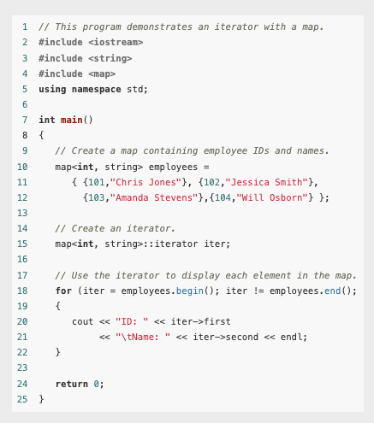
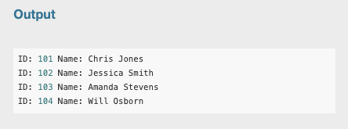
Example
Iter++ is missing in the snapshot

Slide 27
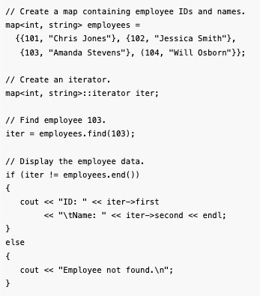
Using an Iterator with a Map
The map class also has a find() member function that searches for an element with a specified key.
If the element is found, the find() function returns an iterator to it.
If the element is not found, the find() function returns an iterator to the end of the map.

Slide 28
The unordered_map Class
Beginning with C++11, the STL provides a class template named unordered_map that is similar to the map class, except in two regards:
(1) The keys in an unordered_map are not sorted in any particular wa
(2) The unordered_map class has better performance.
If you will be making a lot of searches on a large number of elements, and you are not concerned with retrieving them in key order, you should probably use the unordered_map class instead of the map class.

Slide 29
The unordered_map Class
To use the unordered_map class, you must write the #include<unordered_map> directive in your program.
The unordered_map class has a similar set of member functions as the map class.
In most cases, working with an unordered_map is just like working with a map.

Slide 30
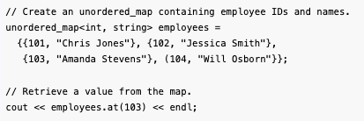
The unordered_map Class
The following code shows an unordered_map being initialized with elements, and then, an element being retrieved and displayed:

Slide 31
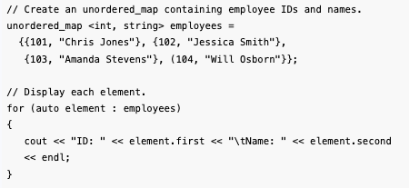
The unordered_map Class
The following code shows an example of using a range-based for loop to display all of the elements in a map:

Slide 32
The multimap Class
The multimap class lets you create a map container in which multiple elements can have the same key.
In other words, duplicate keys are allowed in a multimap.
To use the multimap class, you will need to write the #include<map> directive in your program.
In addition to the usual iterator functions, the multimap class supports all the map member functions
Additionally, there is a member function - equal_range(key) that is peculiar to multimap.

Slide 33
The multimap Class
equal_range(key)
This function returns a pair object whose first member is an iterator pointing to the first element in the multimap that matches the specified key, and whose second member is an iterator pointing to the position after the last element that matches the specified key.
If the specified key is not found, both iterators will point to the element that would naturally appear after the element that was searched for.

Slide 34
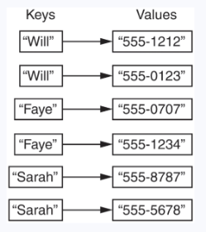
The multimap Class
Let us consider an example. In a phonebook application, you might store names and phone numbers in a multimap container, using the names as keys and the phone numbers as values.
If a person has multiple phone numbers, you would store multiple elements using that person's name as the key.

Slide 35
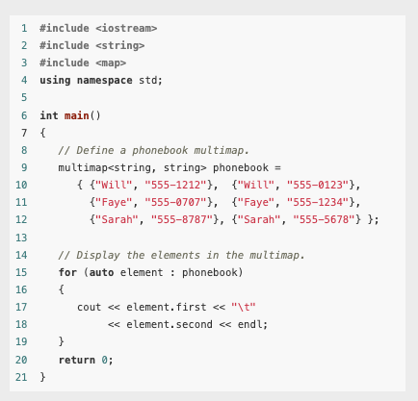
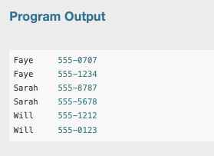
Example

Slide 36
The multimap Class
As with the map class, the elements of a multimap are ordered. When you iterate over a multimap, you retrieve its elements in order of their keys.
The multimap class also provides many of the same member functions as the map class.
However, there are some differences between the multimap class and the map class

Slide 37
Adding Elements to a multimap
Unlike the map class, the multimap class does not overload the [] operator.
So, you cannot write an assignment statement to add a new element to a multimap.
Instead, you can use either the emplace() member function, or the insert() member function.

Slide 38
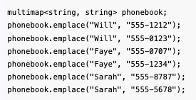
Adding Elements to a multimap
The multimap class's emplace() member function adds a new element to the container.
You simply call the member function, passing the new element's key and value as arguments.
If the element that you are inserting with the emplace() member function has the same key as an existing element, the function adds a new element with the same key. Same for insert()

Slide 39
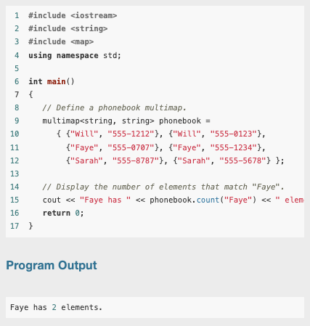
Getting the Number of Elements with a Specified Key
The multimap class's count() member function accepts a key as its argument, and returns the number of elements that match the specified key.

Slide 40
Retrieving the Elements with a Specified Key
Like the map class, the multimap class has a find() member function that searches for an element with a specified key.
If the key is found, the find() function returns an iterator to the first element matching it.
If the element is not found, the find() function returns an iterator to the end of the map.

Slide 41
Retrieving the Elements with a Specified Key
If you want to retrieve all of the elements matching a specified key, use the multimap class's equal_range member function.
The equal_range member function returns a pair object.
The pair object's first member is an iterator pointing to the first element in the multimap that matches the specified key.
The pair object's second member is an iterator pointing to the position after the last element that matches the specified key.

Slide 42
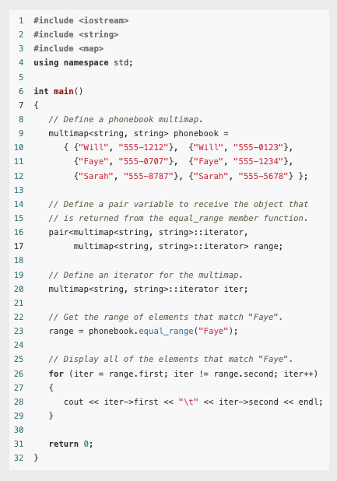
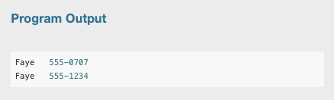
Example
Lines 16 through 17 define a pair variable named range.
The range variable will receive the object that is returned from the equal_range member function.
The object's first and second members will both be iterators for the multimap container.

Slide 43
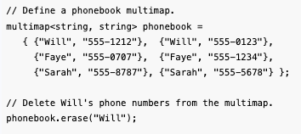
Deleting Elements From a multimap
You can delete, or erase, elements from a multimap using the erase() member function.
You call the erase() member function, passing the key that is associated with the elements that you want to erase.
All of the elements matching the specified key will be erased from the multimap.

Slide 44
The unordered_multimap Class
Beginning with C++11, the STL provides a class template named unordered_multimap that is similar to the multimap class, except in two regards:
(1) The keys in an unordered_multimap are not sorted in any particular order,
(2) The unordered_multimap class has better performance.
If you will be making a lot of searches on a large number of elements and you are not concerned with retrieving them in key order, you should probably use the unordered_multimap class instead of the multimap class.

Slide 45
The unordered_multimap Class
To use the unordered_multimap class, you must write the #include<unordered_multimap> directive in your program.
The unordered_multimap class has a similar set of member functions as the multimap class, and in most cases, working with an unordered_multimap is just like working with a multimap.

Slide 46
Thank you
Final Exam
Date: December 17, 2024
Time: From 1:00 PM to 3:00 PM.
Location: Room KT- 247, Kettler Hall
In-person attendance is mandatory

